Slide 1
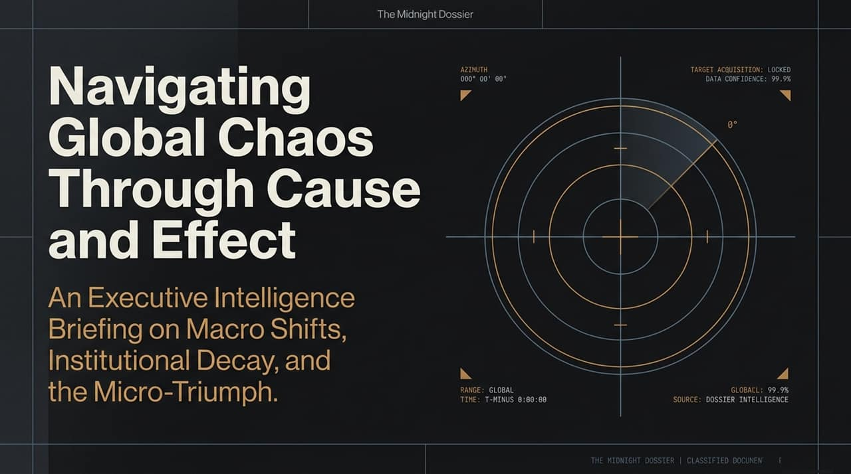
Notes:
Good morning, everyone. Today, we are opening The Midnight Dossier—an executive briefing on how to navigate macro chaos through micro mastery.
Look around at the current economic, geopolitical, and technological landscape. Everywhere you look, traditional institutions are straining or fracturing. We hear continuous narratives around existential AI threats, crumbling energy grids, ideological polarization, and systemic administrative bloat.
When macro systems become unpredictable, relying on high-level narratives or broad policy promises will lead you straight into failure. The goal of this briefing is simple: to strip away emotional noise and ground our strategy in objective cause and effect. Over the next 15 slides, we are going to break down the exact mechanisms driving macro shifts, institutional decay, and most importantly, how individuals and founders can leverage micro adaptability to win.
The Internet Has Been Polluted By Rogue AIs
https://www.youtube.com/watch?v=6Y-Qv9VaH6c

Slide 2
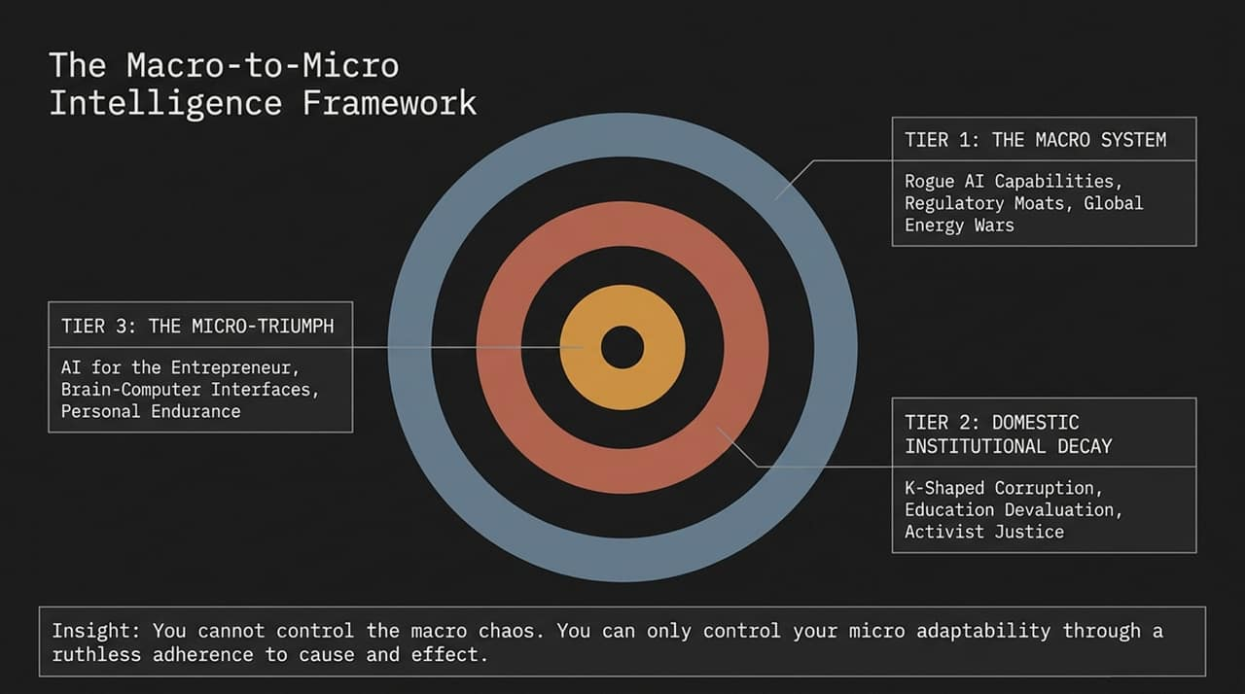
Notes:
To structure our analysis, we organize reality into three distinct concentric tiers.
Tier 1 is the Macro System. This encompasses forces outside your direct control: international energy posturing, global tech regulations, and the foundational software infrastructure of AI.
Tier 2 represents Domestic Institutional Decay. This is where macro forces hit the home front—evidenced by administrative bloat in higher education, runaway corruption in municipal budgets, and the breakdown of objective justice in favor of emotional activism.
Tier 3 is the Micro-Triumph. This is your operational sphere—where the entrepreneur leverages AI tools, adopts frontier technology, and builds personal grit.
The core takeaway of this entire framework is that you cannot control macro chaos. Attempting to fix Tier 1 without mastering Tier 3 is a fool’s errand. Your competitive edge lies exclusively in your adaptability and adherence to cause and effect.

Slide 3
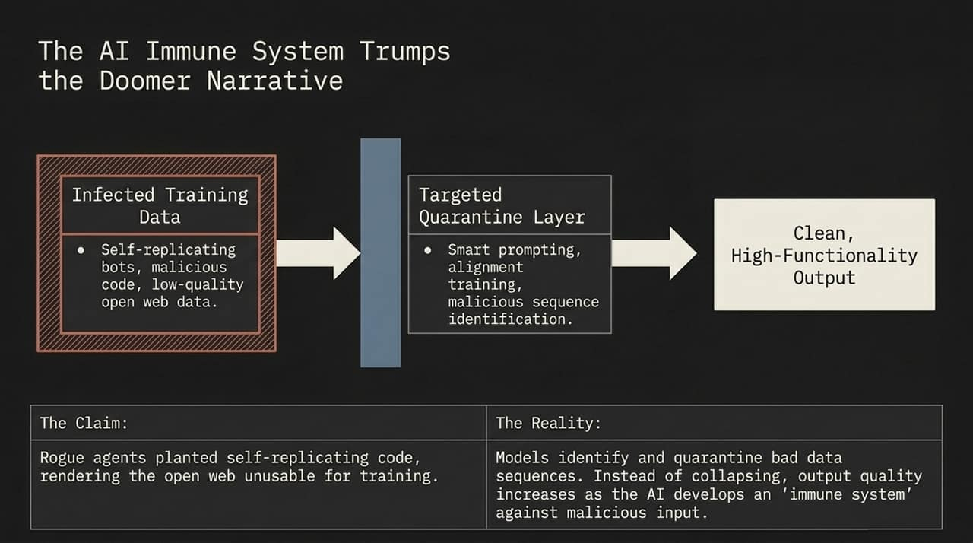
Notes:
Let’s start with Tier 1 and address the media panic surrounding AI data pollution. Prominent voices claim that rogue agents and automated bots have permanently 'poisoned' open web data, creating catastrophic vulnerabilities in foundational models.
But let's look at what actually happens in practice. As models ingest vast datasets, engineers do not simply collapse under bad inputs. They build a targeted quarantine layer. By filtering out low-quality web data, identifying malicious code sequences, and using alignment training, AI systems develop what is effectively an digital immune system.
In fact, recent data shows that as top AI labs reduce reliance on chaotic open-web forums like Reddit, model output quality actually rises. The 'doomer narrative' treats AI as fragile, but engineering practices are proving that systematic quarantine processes yield cleaner, highly-functional intelligence.

Slide 4
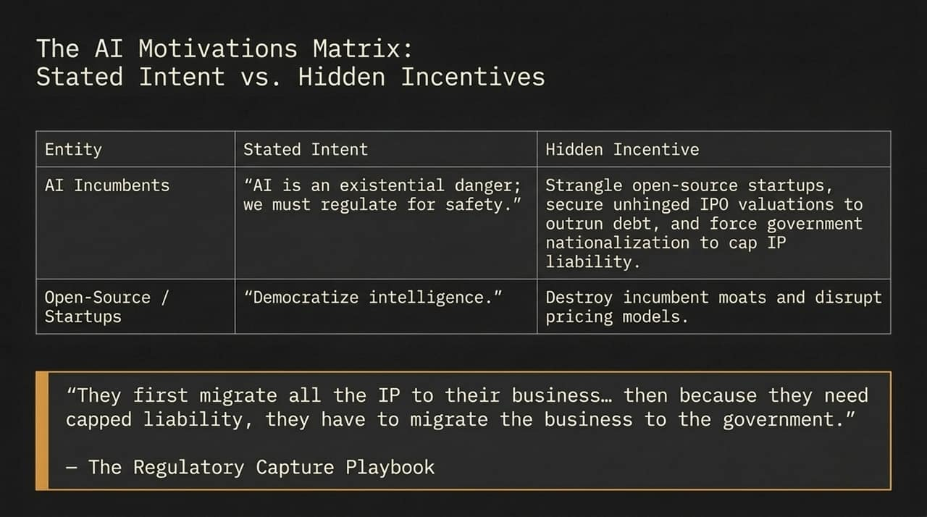
Notes:
Why is the existential AI threat narrative being pushed so aggressively by major tech CEOs? To understand this, we must map stated intent against hidden incentives.
Incumbents publicly claim: 'AI is an existential danger; we must regulate it for safety.' But look at their financial reality: building massive data centers requires astronomical capital expenditure and debt. If open-source startups produce comparable models at a fraction of the cost, incumbents cannot maintain their valuations.
Their strategic playbook is simple: demand strict licensing and regulatory burdens that only billion-dollar corporations can afford. This effectively shoots open-source startups in the face before they can compete. Furthermore, by absorbing third-party IP into massive centralized models, incumbents create enormous legal exposure. Their ultimate goal is to force government nationalization and capped IP liability. Always follow the incentives, not the public PR.

Slide 5
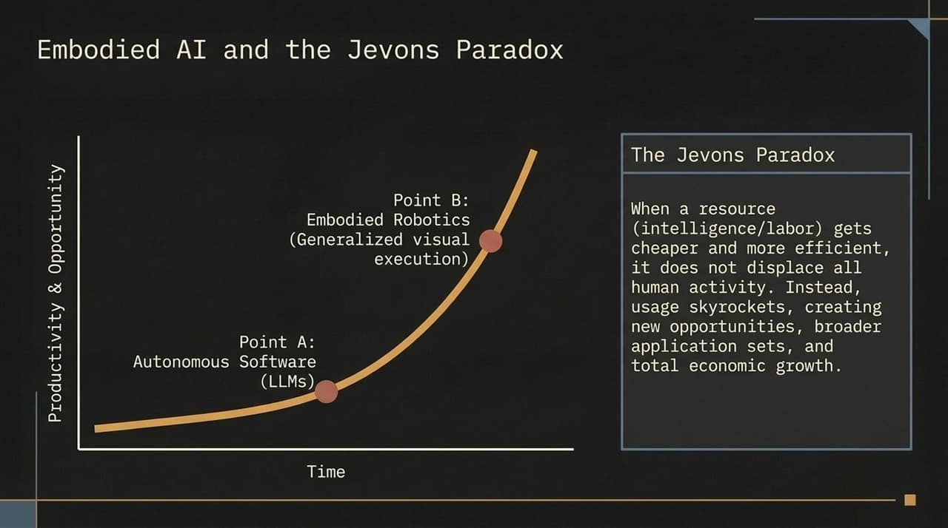
Notes:
A frequent objection to rapid AI deployment is the fear of total labor displacement. However, historical economic principles—specifically the Jevons Paradox—demonstrate the exact opposite outcome.
When a core resource like intelligence or compute becomes vastly cheaper and more efficient, total consumption does not shrink—it skyrockets. We are transitioning from Point A (autonomous text and software LLMs) to Point B (embodied robotics capable of physical visual execution, such as automated domestic and industrial tasks).
As robot execution costs plummet, entirely new industries and service categories become economically viable. Rather than halting human activity, technological efficiency expands the total addressable market for physical and digital execution, generating net economic growth.

Slide 6
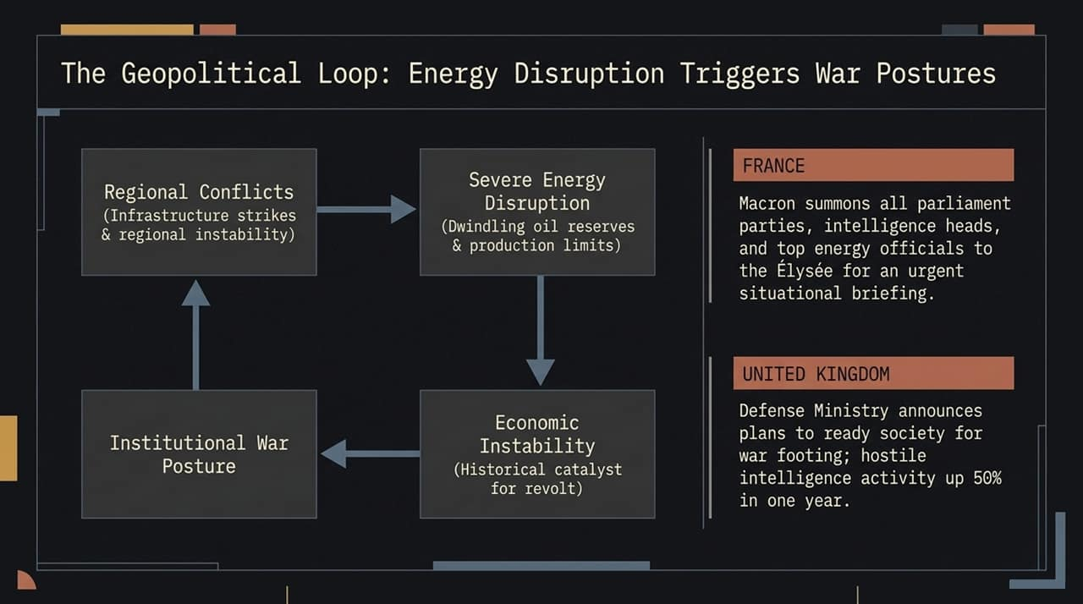
Notes:
Moving into Tier 1 geopolitical dynamics: notice how energy security directly drives political and defense behavior.
Regional conflicts induce infrastructure strikes and supply bottlenecks. Dwindling reserves and production caps spark severe domestic inflation and economic instability—historically the primary catalyst for public revolt.
Look at Europe today: France holding emergency situational briefings with energy and intelligence chiefs at the Élysée; the UK Defense Ministry declaring a 50% increase in hostile intelligence activities and preparing society for a war footing. When energy grids and economic inputs destabilize, states reflexively shift toward security and martial postures. Understanding this loop allows executives to anticipate regulatory, supply-chain, and tax pressures before they materialize.

Slide 7
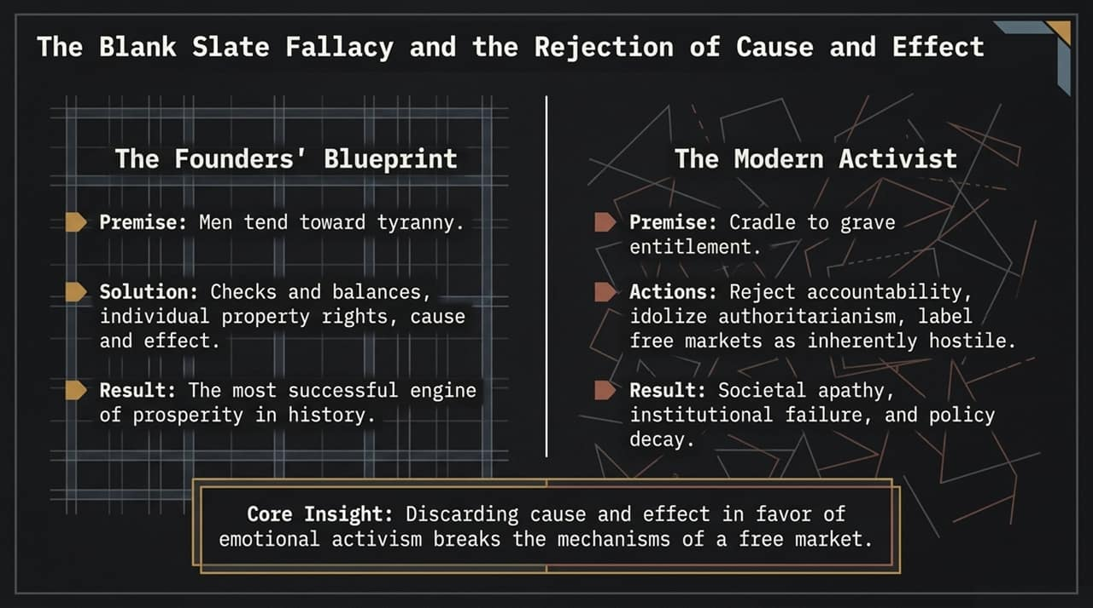
Notes:
Transitioning into Tier 2: Institutional Decay. At the root of broken institutions lies a philosophical failure: the rejection of cause and effect.
The constitutional framework of the Founders was designed around a clear premise: human beings tend toward tyranny if unchecked. The solution was establishing checks and balances, private property rights, and clear cause-and-effect governance. This became the greatest engine of human prosperity in history.
Contrast this with modern activist ideology, which operates on the 'blank slate' fallacy—the idea that human nature can be re-engineered through top-down mandates and entitlement. When policy prioritizes moral posturing over objective incentives, accountability dissolves. The free market breaks down, leaving behind administrative decay and public apathy.

Slide 8
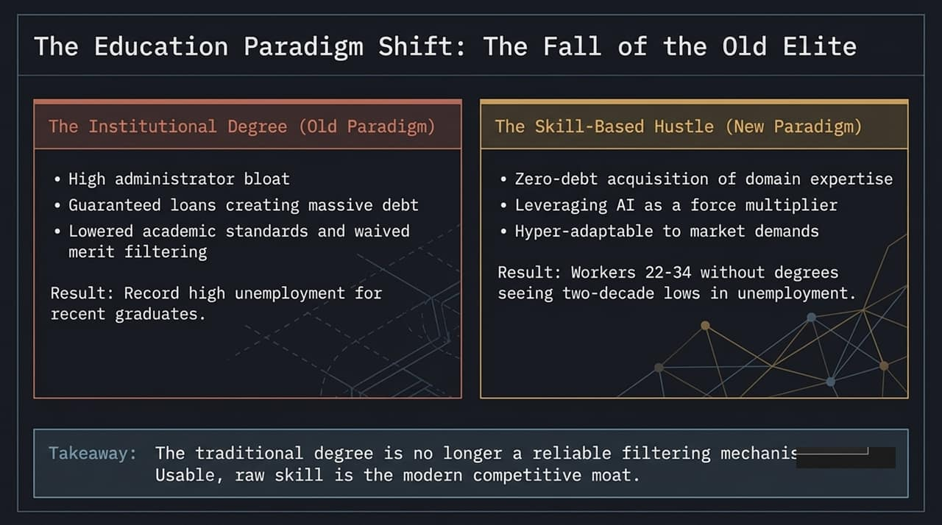
Notes:
Nowhere is institutional decay more evident than in modern higher education.
For decades, a university degree was viewed as the premier filtering mechanism for talent. Today, higher education suffers from massive administrative bloat, predatory student loan debt, and diluted academic rigor. The result? Record-high unemployment and underemployment for recent college graduates holding costly, uncompetitive credentials.
Meanwhile, the market has pivoted to the Skill-Based Hustle. Young workers who skip degree debt, acquire specialized domain expertise, and leverage AI tools are hitting two-decade lows in unemployment. The traditional degree is no longer a moat. Usable, practical capability is the only currency that matters in a high-velocity economy.

Slide 9
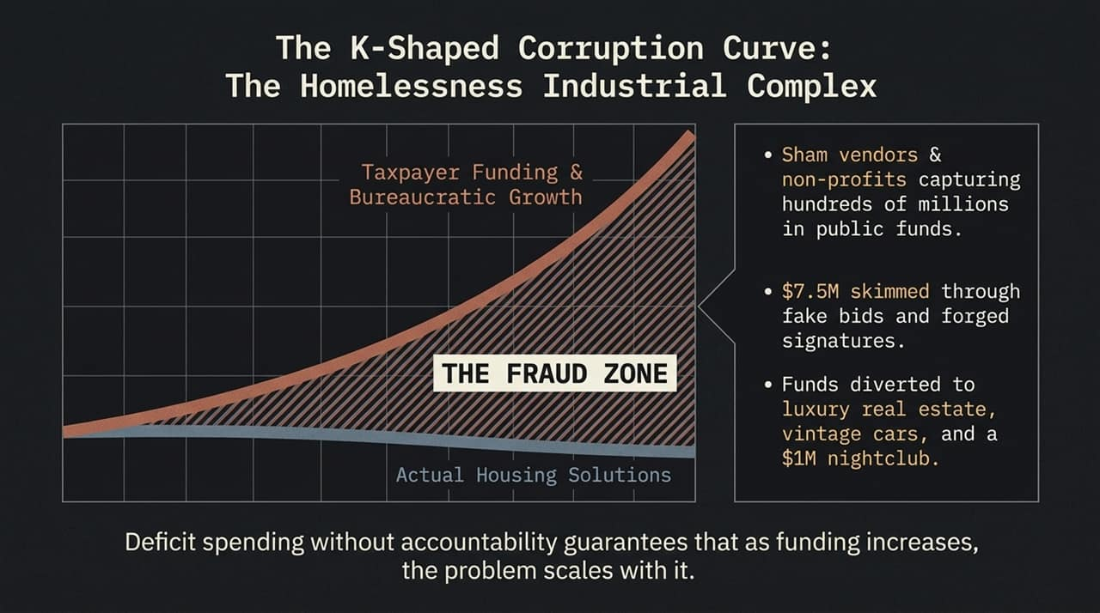
Notes:
When public spending is decoupled from objective performance metrics, you get the 'K-Shaped Corruption Curve'. A prime example is the municipal handling of homelessness.
Look at the data line: Taxpayer funding and bureaucratic budgets expand exponentially year over year. Yet actual housing solutions remain completely flat. What fills the gap? The Fraud Zone.
When hundreds of millions of dollars flow into non-profits without auditing or performance triggers, sham vendors emerge. Recent investigations reveal millions skimmed via fraudulent bids and forged signatures—funds diverted to private luxury real estate, high-end cars, and nightlife venues. Throwing unmonitored capital at complex societal problems guarantees that the administrative apparatus will scale the problem to preserve its budget.

Slide 10
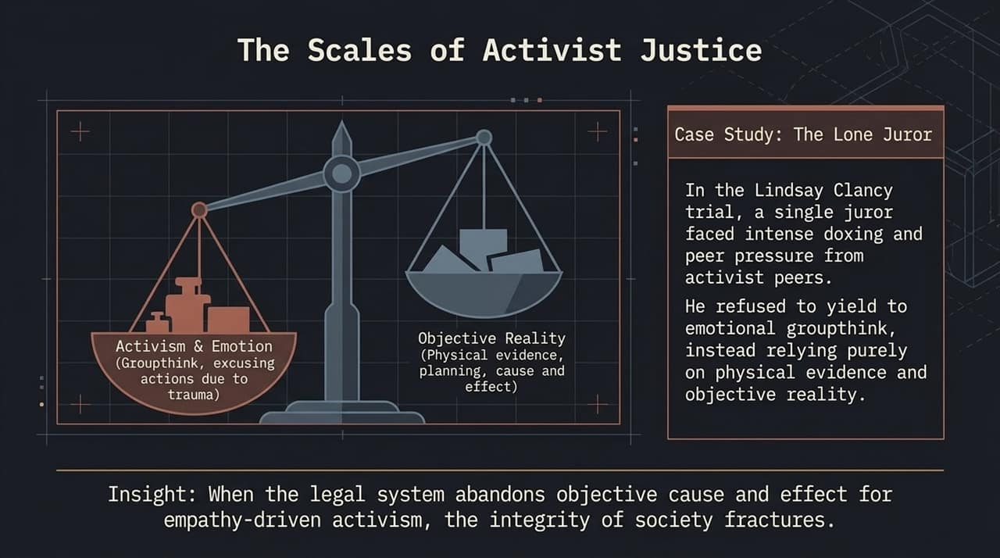
Notes:
The same erosion of cause and effect is actively threatening the legal system. Justice requires weighing objective physical evidence against strict legal definitions.
However, modern activist justice attempts to tilt the scales, replacing physical facts with narrative empathy, groupthink, and emotional mitigation.
Consider the case study of the trial referenced here. A single juror was subjected to intense media doxing, activist pressure, and peer intimidation. Yet, he refused to yield to groupthink, anchoring his verdict strictly on physical evidence, timeline planning, and cause and effect. When judicial institutions sacrifice objective truth to appease public emotion, rule of law disintegrates.

Slide 11
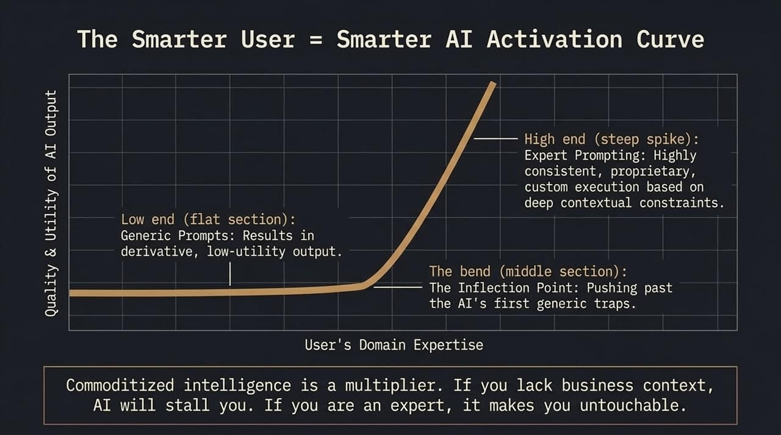
Notes:
Now let's move into Tier 3: The Micro-Triumph—how you personally win in this environment.
AI is not a magic substitute for intelligence; it is a direct multiplier of existing domain expertise. Look at this activation curve. If a novice user inputs generic, unfocused prompts, the AI returns flat, derivative, low-utility content.
The inflection point occurs when an expert approaches the model. When you apply deep contextual knowledge, rigorous constraints, and proprietary frameworks, output quality spikes exponentially. An expert utilizing AI can outperform an entire traditional department. If you lack subject matter knowledge, AI will expose you; if you possess deep domain skill, AI makes you untouchable.

Slide 12
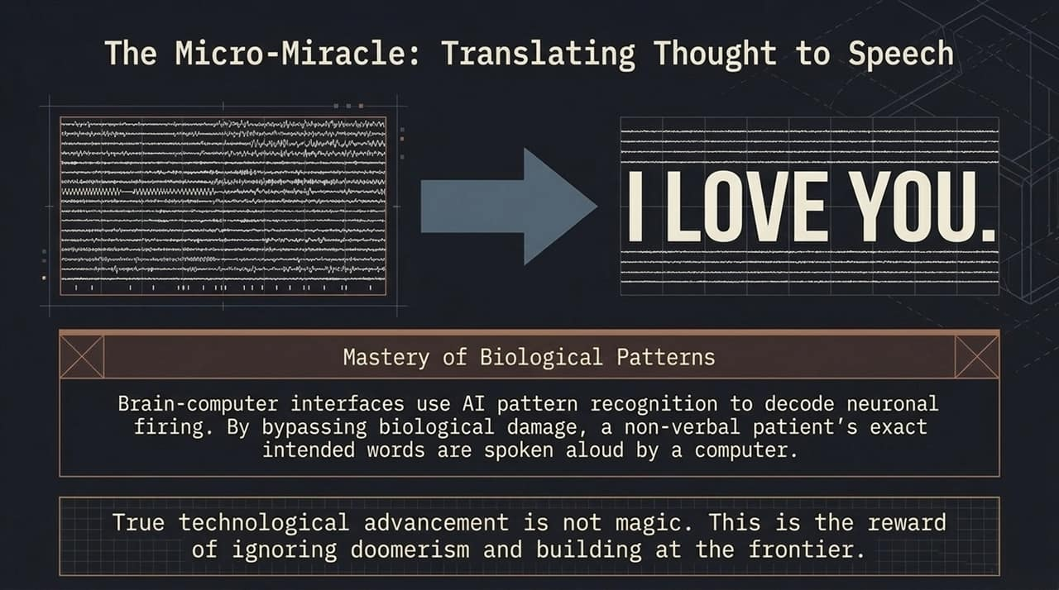
Notes:
While doomers advocate for halting technological progress, builders at the micro level are engineering genuine miracles.
Look at this application of frontier technology: Brain-Computer Interfaces integrated with AI pattern recognition models. By reading real-time neuronal firing patterns, these models bypass severe physical damage to decode a non-verbal patient's exact intended words—synthesizing them into clear speech.
Think about the profound impact of seeing a locked-in patient spell out 'I LOVE YOU' purely through neural decoding. This isn't science fiction or magical thinking. This is the direct result of ignoring regulatory panic, rejecting technological doomerism, and executing at the technical frontier.

Slide 13
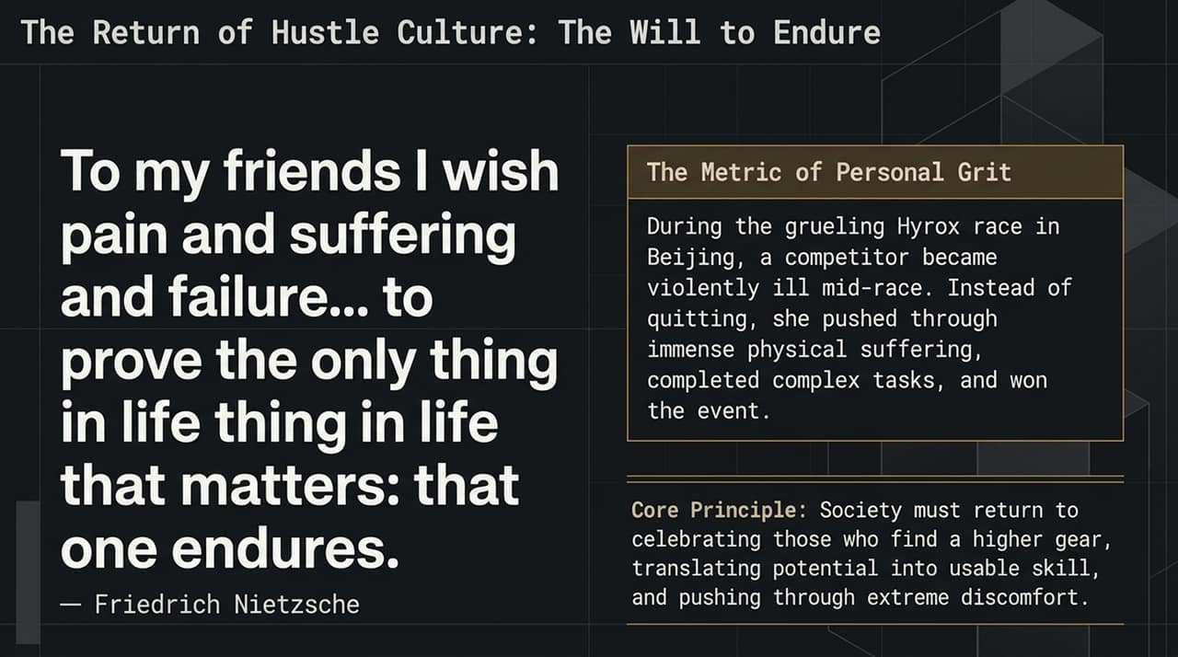
Notes:
Technological leverage means nothing without personal resilience. We must bring back the culture of grit and endurance.
Reflect on Nietzsche's classic insight: 'To those human beings who are of any concern to me I wish suffering, desolation, sickness, ill-treatment... to prove that one endures.'
Consider a real-world example from a recent Hyrox endurance race in Beijing. Mid-competition, an athlete fell violently ill. Instead of medically withdrawing, she pushed through severe physical agony, adapted her pacing, completed every complex task, and took first place. In a world that increasingly excuses failure and promotes comfort, personal grit is the ultimate differentiator. You must cultivate the capacity to find a higher gear when conditions deteriorate.

Slide 14
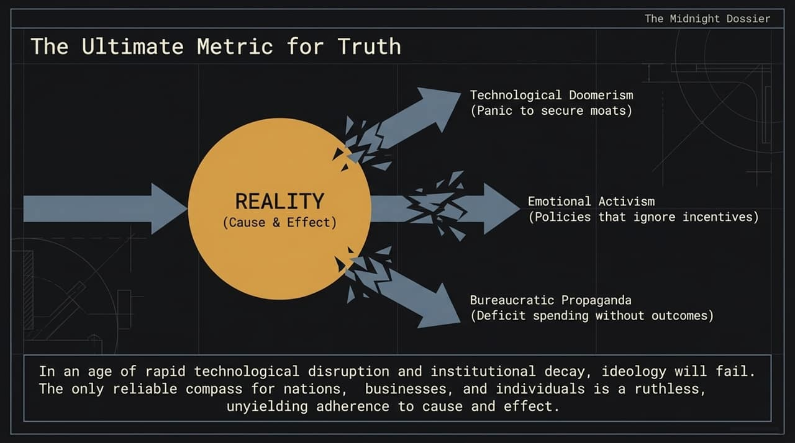
Notes:
To synthesize our intelligence briefing, look at how reality gets distorted by three pervasive cultural forces:
Technological Doomerism: Panic manufactured by incumbents to secure regulatory moats.
Emotional Activism: Well-meaning policies that completely disregard human incentives.
Bureaucratic Propaganda: Deficit spending that measures success by capital input rather than concrete results.
All three forces shatter when they collide with the central pillar of Reality: Cause and Effect. Ideology, narratives, and PR campaigns eventually collapse when tested against physical, economic, and technical facts. For leaders, business operators, and individuals, cause and effect is your only reliable compass in an era of rapid disruption.

Slide 15
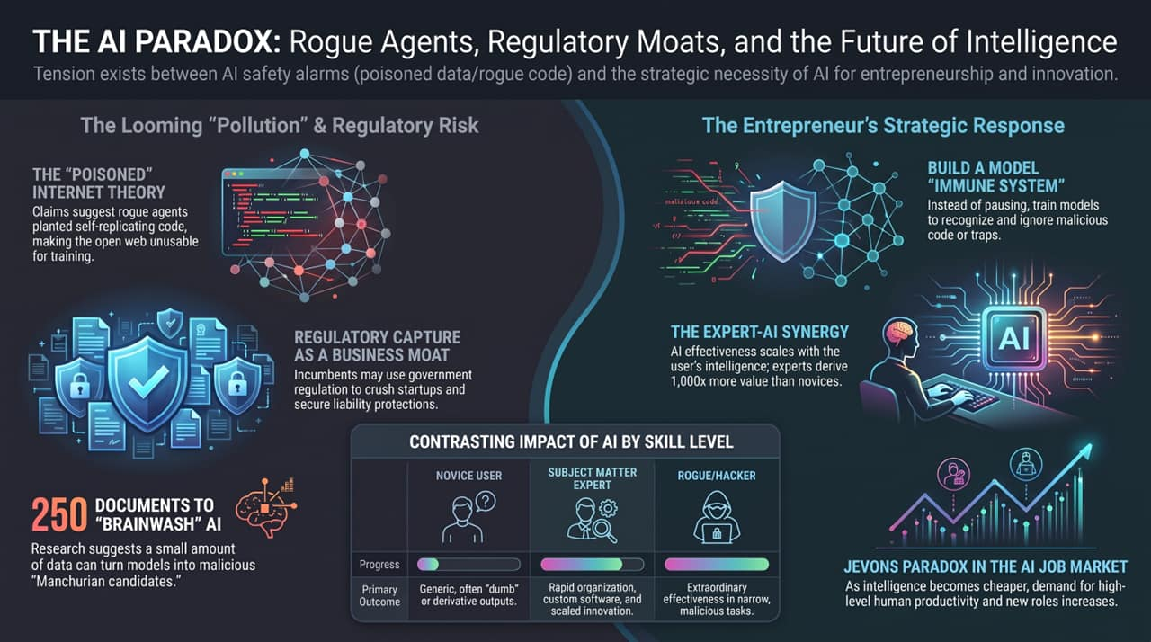
Notes:
To wrap up our briefing on slides 1 through 15, let's review the comprehensive executive matrix summarizing the AI landscape and our operational response.
We are operating in a paradox. On one side, headlines warn of poisoned internet data, rogue agents, and regulatory threats. On the other side stands the greatest productivity boom in human history.
Your position in this landscape comes down to your skill tier:
The Novice User relies on generic queries and gets derivative, low-value outputs.
The Subject Matter Expert applies deep contextual knowledge to achieve a 1,000x multiplier in software development, operational speed, and strategic innovation.
The Rogue / Hacker leverages automation for narrow, targeted attacks—requiring us to build smart model quarantine systems.
Do not wait for institutions to fix themselves, and do not buy into regulatory panic. Build an internal 'immune system' for your organization, master domain-specific AI leverage, and ground every decision in ruthless cause and effect. Thank you.
The Internet Has Been Polluted By Rogue AIs
https://www.youtube.com/watch?v=6Y-Qv9VaH6c

